Slide 2
System Center Configuration Manager R3 Overview
Wally Mead, Senior Program Manager
Microsoft Corporation

Slide 3
Agenda for Today’s Session
Quick overview of ConfigMgr 2007 R3
High level features and timeline
Deep dive into power management
Lots of reports and demos
Overview of other features in ConfigMgr 2007 R3
Prestaged media, delta AD discovery, DCM compliance reporting, and collection management

Slide 4
Overview of Configuration Manager 2007 R3
Features in this add-on
Power management
Active Directory delta discovery
Prestaged media for operating system deployment
Easier ability to create collections based on DCM compliance states
Easier ability to manage/administer collection membership

Slide 5
Requirements for Configuration Manager 2007 R3
Configuration Manager 2007 R3
Requires Configuration Manager 2007 SP2
Add-on to Configuration Manager 2007 SP2
It is not an upgrade
Specifically for power management:
Windows XP SP3, Windows Vista SP1+, Windows 7 clients
Windows Server 2003, Windows Server 2008, Windows Server 2008 R2 not officially supported
Hardware that supports power management
If the hardware doesn’t support it, we can’t magically make it work

Slide 6
Power Management Scope
Client scenarios
Based on Stand by/Sleep
Wake up for management
Dashboards of current power state
Power management policy create and set
Report savings

Slide 7

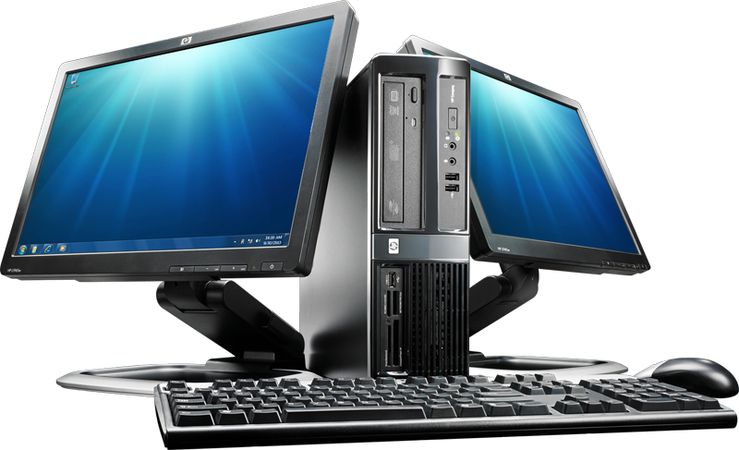



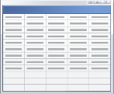

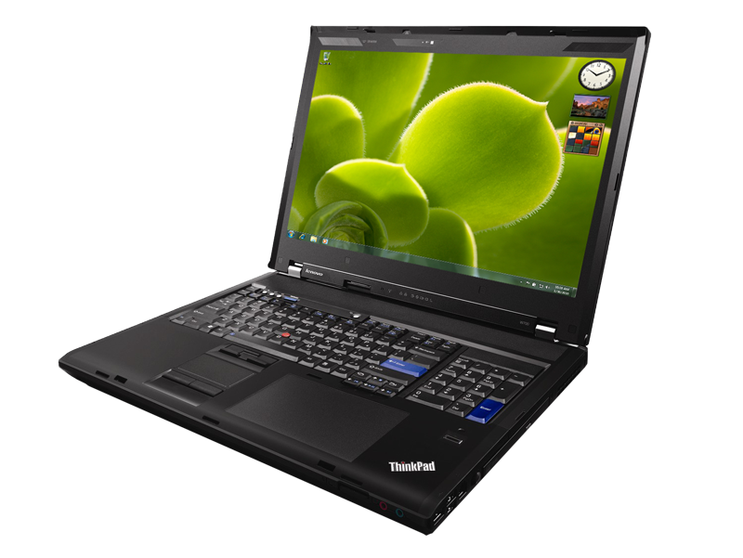





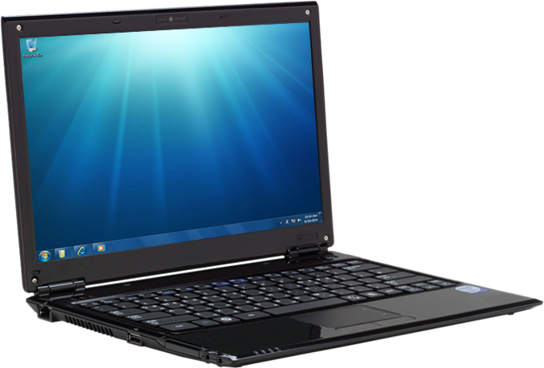
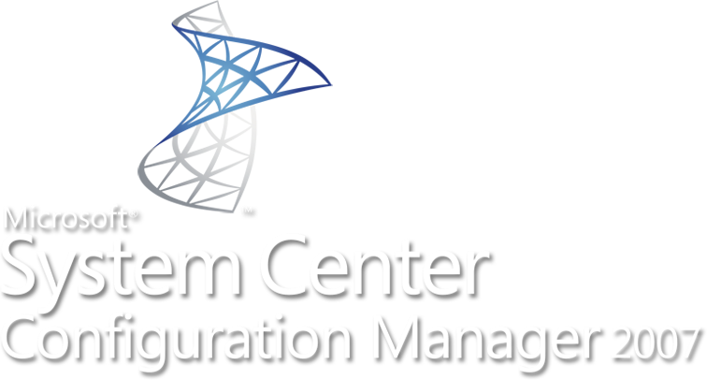
System Center Power Management
Monitor current power state and consumptions
Plan and create a power management policy, check for exceptions
Apply power management policy
Check compliance and remediate non-compliance
Report saving in power consumption, environmental impact, and costs
Power Planning
Power Policy Configuration and Application
Power Configuration, Monitoring, Remediation
Power Savings Reporting

Slide 8
Phase 1: Monitor Current State and Consumption
Enable Power Management Client Agent
Hardware Inventory Client Agent required
Gather power consumption and carbon footprint per collection
Machine utilization trends per collection based on user activity
Peak, non-peak and zero activity times
Current power settings used by machines
Calculate energy consumption (kWh, $ and CO2 footprint)

Slide 9
Power management configuration
demo

Slide 10
Phase 2: Plan and Create Power Management Policies
Analyze the data and define right power policy based on user activity:
Example: user activity is heavy 8 – 11 AM , and picks up again 1 – 4:30 PM
91% of people zero activity by 5 PM
98% of people zero activity during weekend
Look for clients that can’t support power management
Exclude clients that shouldn’t be managed for power
Define policy for each facility (organization, department)
Define different policy for peak and non-peak times
Out of the box power policies
Balanced, Power saver, High performance (Windows XP, Windows Vista, Windows 7)
Create new customized power policies

Slide 11
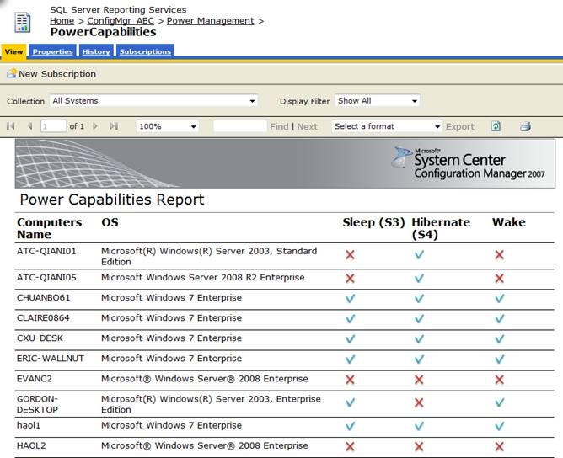
Power Capability Report

Slide 12
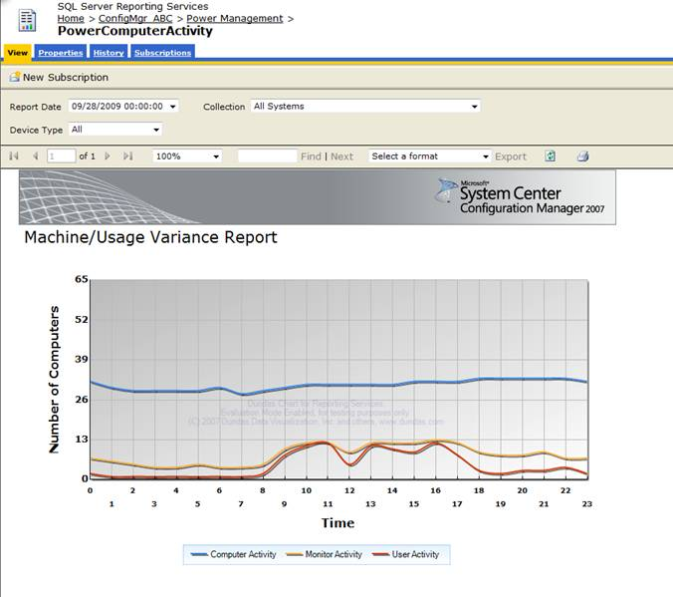
Machine and User Activity Report

Slide 13
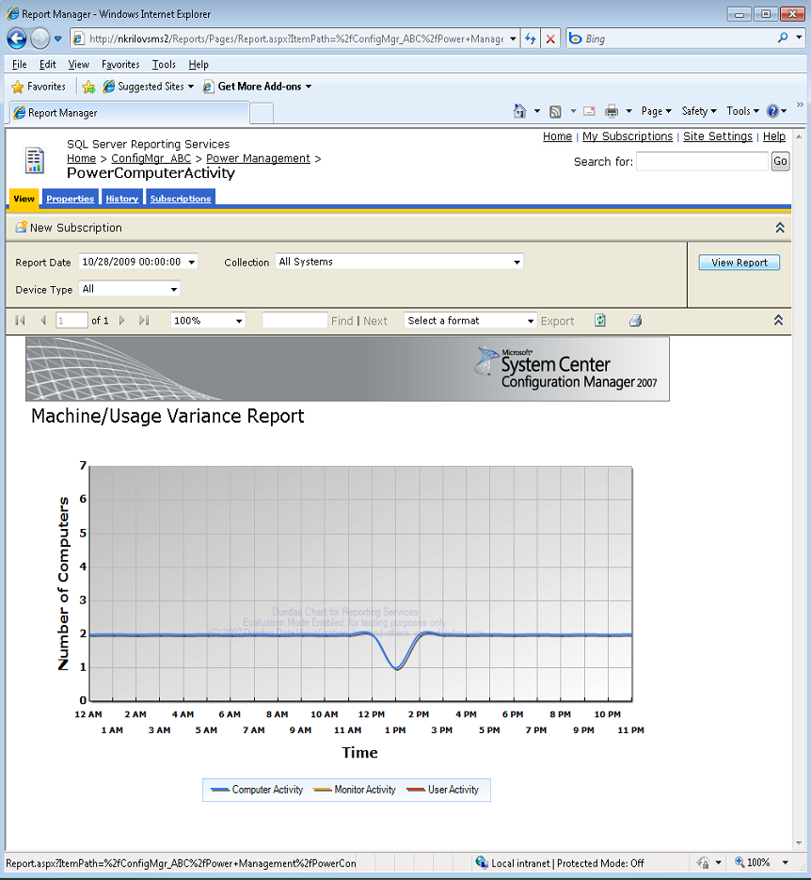

Slide 14

Power Consumption Data
 | Energy consumed/hour (Watts)
 | Energy Star | Standard
Monitor
Power consumed by standard monitor in active mode | 28 | 73
Power consumed by standard monitor in sleep mode | 2 | 3
Systems
Power consumed by standard desktop in active mode | 60 | 84
Power consumed by standard desktop in sleep mode | 4 | 6
Power consumed by standard laptop in active mode | 16 | 20
Power consumed by standard laptop in sleep mode | 1 | 1

Slide 15
Phase 3: Apply Power Management Policy
Allow power policy to be applied at the collection level
Places focus on collection architecture
Define peak and non-peak time for collections
Define policy exceptions
When multiple policies applied choose policy that provides more system availability to the user
Allow clients to wake up per collection (if using AC power) during specified time to check for other ConfigMgr policies to be implemented

Slide 16
Power management policy configuration
demo

Slide 17
Power management reporting
demo

Slide 18
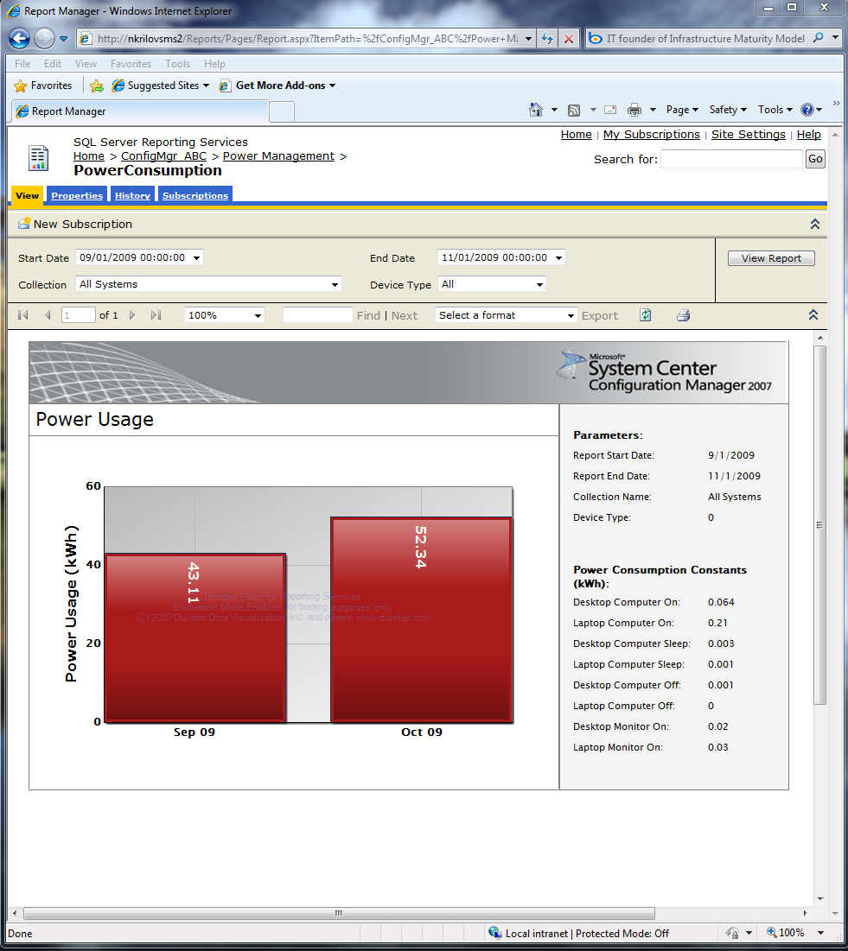

Slide 19
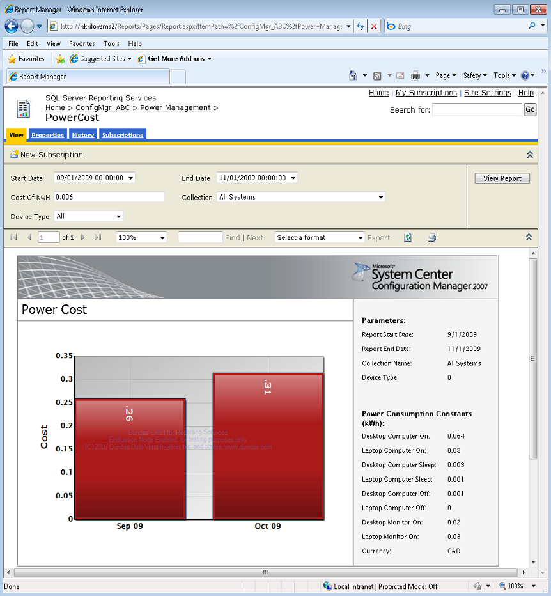

Slide 20
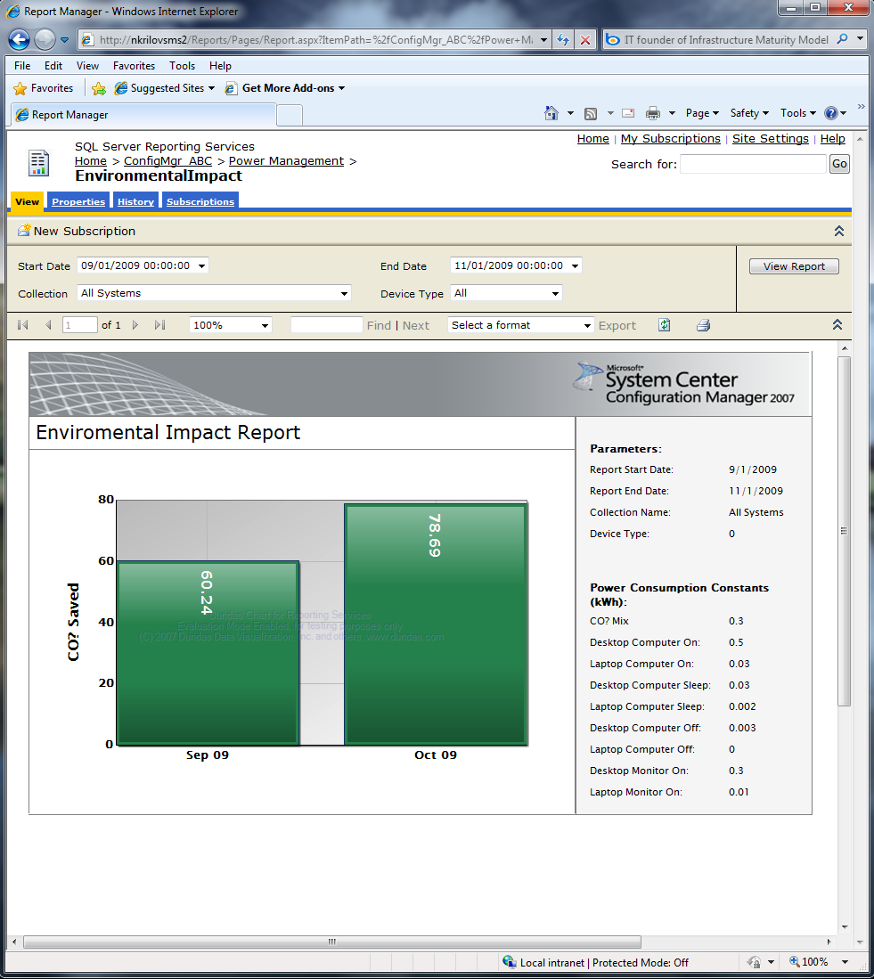

Slide 21
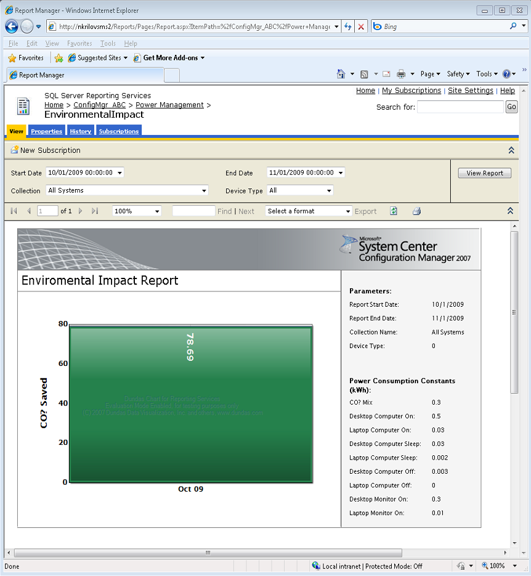

Slide 22
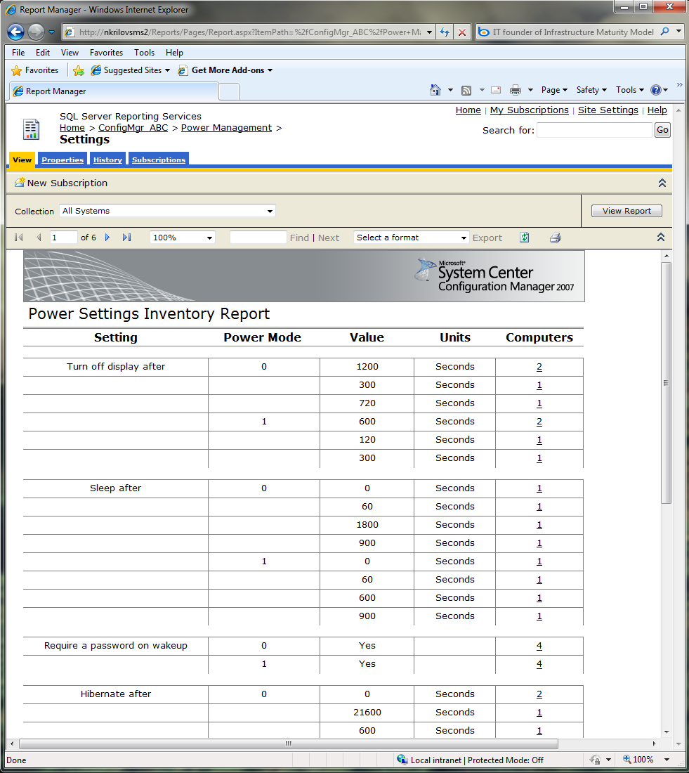

Slide 23
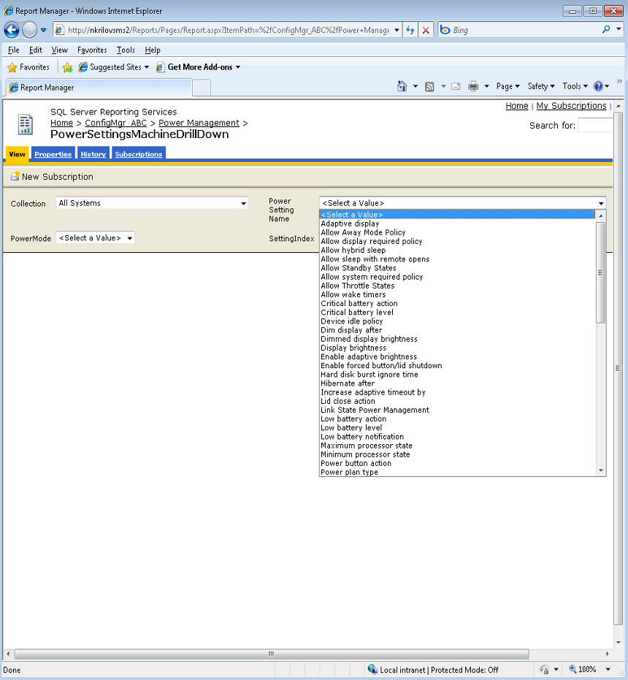

Slide 24
Additional ConfigMgr R3 Features
In addition to the Power Management capabilities, Configuration Manager 2007 R3 includes:
Active Directory Delta Discovery
More frequent, less impact, discovery to add new resources to the Configuration Manager site database
Dynamic Collection Updates
More frequent, less impact, feature to update collections based on new resource record data
Prestaged Media for Operating System Deployment
Creates a custom .wim with boot and OS image data
Shortens time to deploy new systems at your location
Enhanced Collection Management
Right-click actions to ease collection management

Slide 25
Delta AD Discovery
Each AD discovery query has 2 tasks:
1. Discover any changes to any users or machines, based on the query, that would likely affect targeting (default is 5 minutes)
2. Perform a periodic “full scan” to capture users and machines last logged time, ensuring active users and machines are not made obsolete
On an individual discovery method, can still initiate a full scan on demand

Slide 26
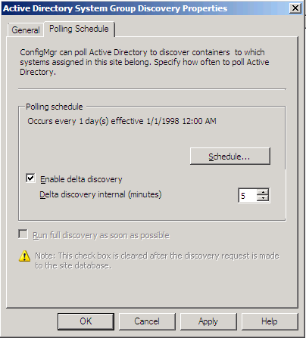
Delta AD Discovery
Active Directory queries supported are:
User
User Group
System
System Group
Able to view the last start time and last end time for each query as well as the average duration, calculated on the last 10 executions
Note: Delta Discovery is not enabled by default

Slide 27
Collection Evaluation
Focus for R3 is evaluating new systems
New collection setting ‘Dynamically add new resources’
Full evaluations are still processed in the same way
A new collection needs a full evaluation to show existing clients
How it works:
Collections are evaluated by periodically executing a query
Results are inserted into a temporary table
This table is then merged into the master collection results table (CollectionMembers)
If there is no change in results, master results table not changed
If only a few resources have changed, evaluation process faster due to only processing changed resources

Slide 28
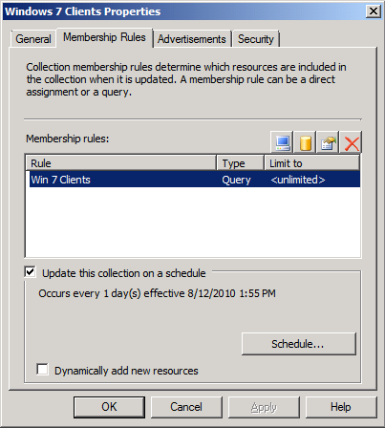
Dynamic Collection Evaluation
Step 1
Collection is configured to dynamically add new resources

Slide 29
Dynamic Collection Evaluation
Step 2
Resource that fast collections apply to are:
Initially discovered
Provisioned via OSD
Scanned for initial hardware inventory
Upgraded to a higher ConfigMgr client version
Resource ID inserted into change tracking table where a separate collection evaluator thread is run (5 min) and evaluates collections marked for fast evaluation
Step 3
1. Fast Collections do not apply to known machines within ConfigMgr, only the above resources
2. Full evaluations are still processed in the same way

Slide 30
Delta AD Discovery and Dynamic Collection Evaluation
demo

Slide 31
Software Distribution Process for New Systems
Activity | ConfigMgr07 | ConfigMgr07 R3
User/Device created in AD or AD Replication | Depends on AD | Depends on AD
User/Device discovered in AD – Inserted into ConfigMgr DB | Default = 24 hours | Min = 5 mins
User/Device added to Collection | Default = 24 hours, Min ~ 1 hour | Default = 24 hours, If fast collection, then min is 5 minutes
Policy created for User/Device | ~5-30 mins depending on queue | ~5-30 mins depending on queue
Device requests policy for User/Device | Once an hour | Once an hour or when user logs on (CM07Sp2 contained change to evaluate policy at logon, doesn’t take 3-5 minutes anymore)
Client evaluates policy | Within 1-2 min of receiving policy | Within 1-2 min of receiving policy
Client downloads and installs content | Depends on content | Depends on content

Slide 32
Scale Improvements in R3
Supports 300,000 clients in a hierarchy (at the central site) when using the default settings for all Configuration Manager 2007 features
NOTE: No change to other site and site role supported numbers

Slide 33
Admin Console Improvements
Add to Collection
New Collection
Remove from Collection
Add Resources
Adds the currently selected resource(s) to an existing collection (as specified by the administrator)
Adds the currently selected resource(s) to a new collection (as specified by the administrator)
Removes the currently selected resource(s) from the current collection
Launches a dialog that allows administrators to search for resources and add create direct membership rules

Slide 34
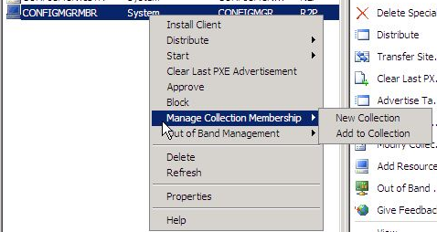
Resource Management Improvements
Add to Collection - Adds the currently selected resource(s) to an existing collection (as specified by the administrator)
New Collection - Adds the currently selected resource(s) to a new collection (as specified by the administrator)

Slide 35
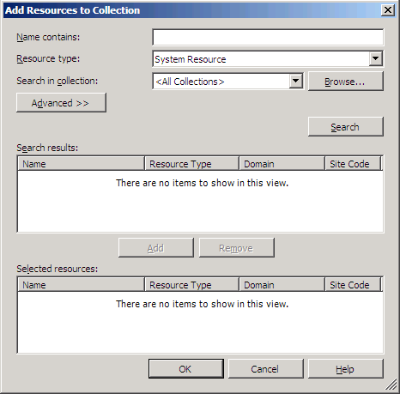
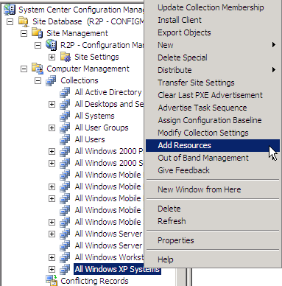
Resource Mgmt Improvements Cont.
Remove from Collection - Removes the currently selected resource(s) from the current collection
Add Resources - Launches a dialog that allows administrators to search for resources and add create direct membership rules

Slide 36
OS Deployment - Prestaged Media
Customers requirements:
A way to integrate with OEM factory imaging
Leverage imaging at the OEM to speed up their new hardware deployments
Keep inline with their current processes
Prevent new administrative overhead
R3 Enhancement:
Provides a way to use existing packages in ConfigMgr
Integrates with existing task sequences
Easy and repeatable process to create media

Slide 37
Prestaged Media – How it works
Integrated into the Task Sequence Media Wizard
Hybrid .wim file containing boot media and operating system .wim file
New MediaType (“OEMmedia”) added for condition statements to leverage one task sequence
Apply OS action updated to interact with new MediaType, will not wipe drive when set

Slide 38
OS Deployment Enhancements
demo

Slide 39
The Roadmap for Configuration Manager 2007 R3
Public beta released in April, 2010
RTM in October, 2010
Available to Software Assurance customers

Slide 40
Links and Resources
System Center Nexus Team Blog - link
What’s new SP2 TechNet Documentation Library- link
Configuration Manager download
ConfigMgr Product Homepage – link
Configuration Manager Product Team Blog – link
Windows MDOP – link
Windows Server 2008 R2 Branch Cache overview – link
Branch Cache ConfigMgr Deployment Guidance – link

Slide 41

© 2010 Microsoft Corporation. All rights reserved. Microsoft, Windows, Windows Vista and other product names are or may be registered trademarks and/or trademarks in the U.S. and/or other countries.
The information herein is for informational purposes only and represents the current view of Microsoft Corporation as of the date of this presentation. Because Microsoft must respond to changing market conditions, it should not be interpreted to be a commitment on the part of Microsoft, and Microsoft cannot guarantee the accuracy of any information provided after the date of this presentation. MICROSOFT MAKES NO WARRANTIES, EXPRESS, IMPLIED OR STATUTORY, AS TO THE INFORMATION IN THIS PRESENTATION.

